Slide 1
Stock Market Analysis using Time Series Data
Shrisha Patil

Slide 2
Basics of the Stock Market
The stock market is used to price a company and its shares based on various factors such as physical vs. physiological, rational vs. irrational, etc.
Since there are so many various factors to consider, predicting how the stock market will perform is a very difficult task. The factors make the share prices extremely volatile and difficult to accurately predict.

Slide 3
Machine Learning in Stock Market Analysis
As we see Machine Learning rising in our environment day by day, let us see how we can use the algorithms to try and analyze such an unpredictable dataset like the stock market.
Machine Learning techniques have the potential to unearth patterns and insights we didn’t see before, and these can be used to make unerringly accurate predictions.

Slide 4
Types of Stock Market Analysis
There are 2 types of Stock Market Analysis:
-->Fundamental Analysis
-->Technical Analysis
Fundamental Analysis deals with the prediction of the future profitability of a company based on its current environment and performance.
Technical Analysis is the reading of the charts, basically using statistics, to find the trends in the numbers. Technical Analysis is what we will be using here.

Slide 5
The Data
I have decided to use the Hindustan Aeronautics Limited (HAL) stock history- National Stock Exchange of India (NSE) dataset from Quandl.
The link to the dataset is given below:
https://www.quandl.com/data/NSE/HAL-Hindustan-Aeronautics-Limited

Slide 6
In the dataset, we can see that there are 8 parameters that we are using:
Date
Open
High
Low
Last
Close
Total Trade Quantity
Turnover(Lacs)
The columns “Open” and “Close” represent the starting and final price at which the stock is traded on a particular day.
“High”, “Low” and “Last” represent the maximum, minimum, and last price of the share for the day,respectively.
“Total Trade Quantity” is the number of shares bought or sold in the day and “Turnover (Lacs)” is the turnover of the particular company on a given date.

Slide 7
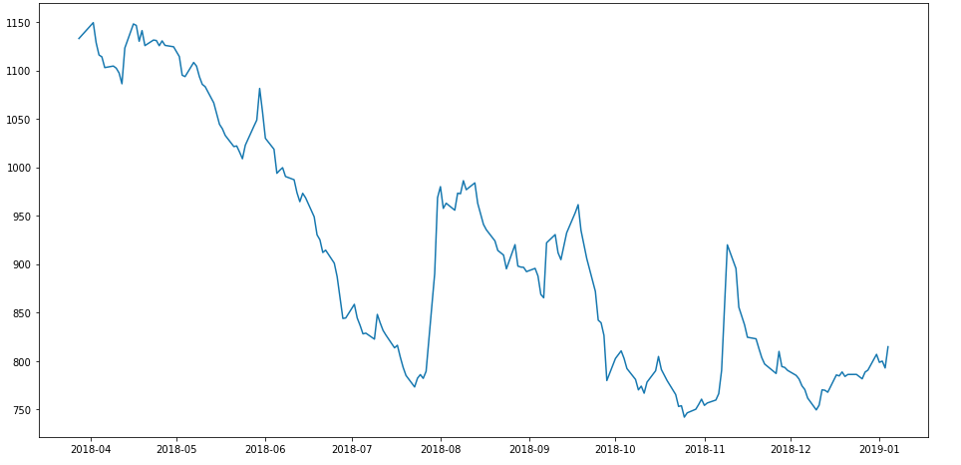
The profit/loss of a company for a given date is calculated based upon the closing price of the share of the company. Therefore, it makes sense to have the close price of the stocks as the target variable.
In the code, we first plot the target variable to see how it shapes our data.

Slide 8
Moving Averages
We use averages in our daily lives without thinking about it. So, let us use this as a starting point to make our predictions.
The predicted closing price for each day will be the average of a set of previously observed values. Instead of using the simple average, we will be using the moving average technique which uses the latest set of values for each prediction.
In other words, for each subsequent step, the predicted values are taken into consideration while removing the oldest observed value from the set.
The first step is to create a dataframe that contains only the “Date” and “Close” price columns, then split it into train and validation sets to verify our predictions.

Slide 9
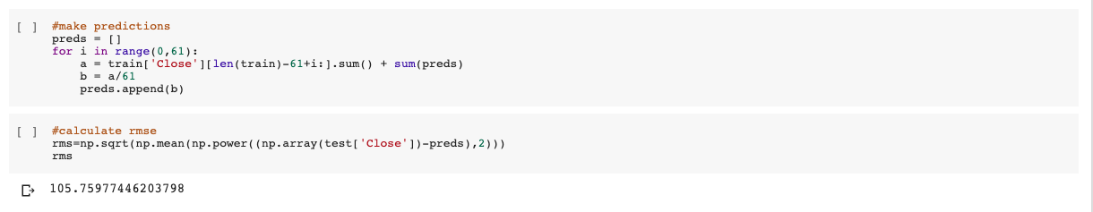
So, using Moving Averages and making the predictions for the data, we calculate the Root Mean Square Error (RMSE) value of our model. This error value shows us how much our model is deviating, or in other words, how well our model is fitted. The higher the rmse value, the worse the model fit is.
For the moving average model, the rmse value is 105.76. This is a very high number. So let’s use some other models to see if we can fit the data with less error.

Slide 10
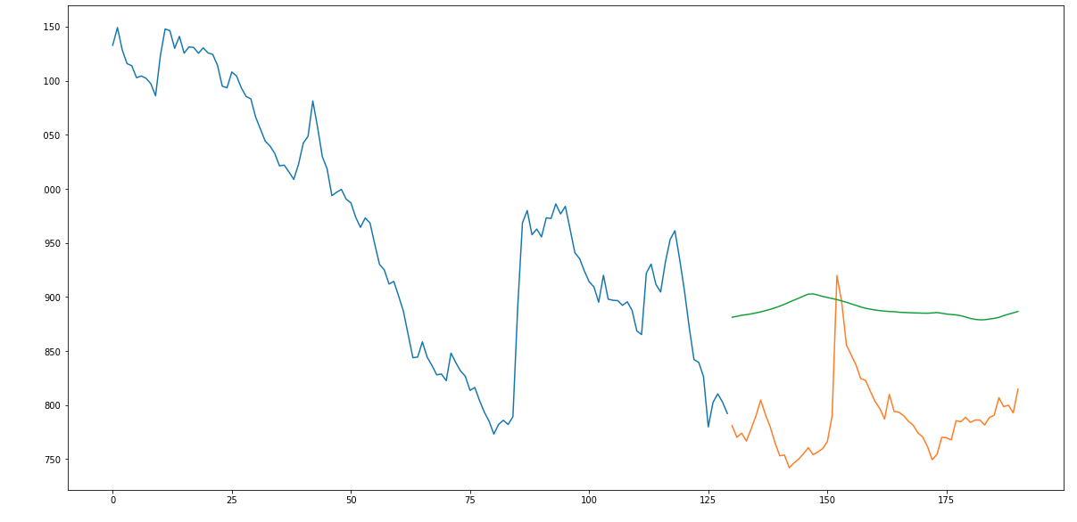
Plot for the moving average model

Slide 11

Linear Regression
Let us try the Linear Regression Algorithm to try and fit the model.
The most basic machine learning algorithm that can be implemented on this data is linear regression. The linear regression model returns an equation that determines the relationship between the independent variables and the dependent variable.The equation for linear regression can be written as:
Here, x1, x2,….xn represent the independent variables while the coefficients θ1, θ2, …. θn represent the weights.

Slide 12
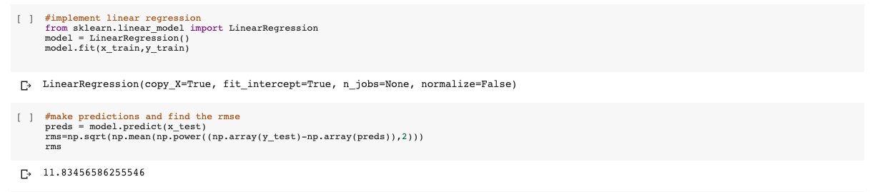
Here, the rms value becomes 11.83 which is very less. So we can see that when we use Linear Regression, the model becomes well fitted.

Slide 13
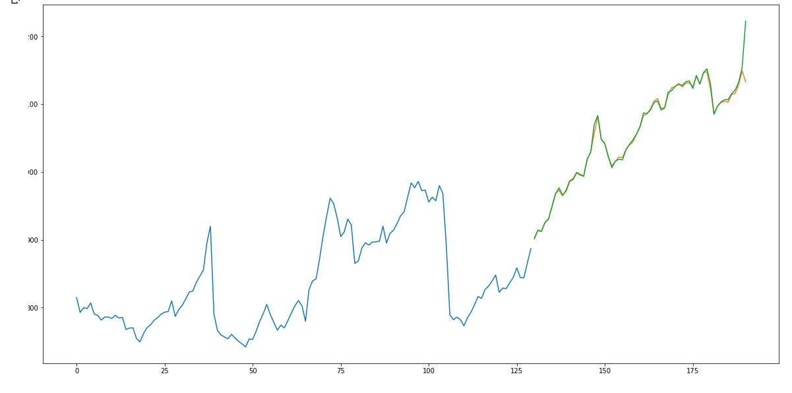
Plot for Linear Regression Model

Slide 14
KNN
Another interesting ML algorithm that one can use here is KNN (k nearest neighbours). Based on the independent variables, KNN finds the similarity between new data points and old data points.
For KNN, the RMSE value becomes 165.76. This value is higher than both our previous models, so we can say that KNN is not a good fit for this dataset.

Slide 15
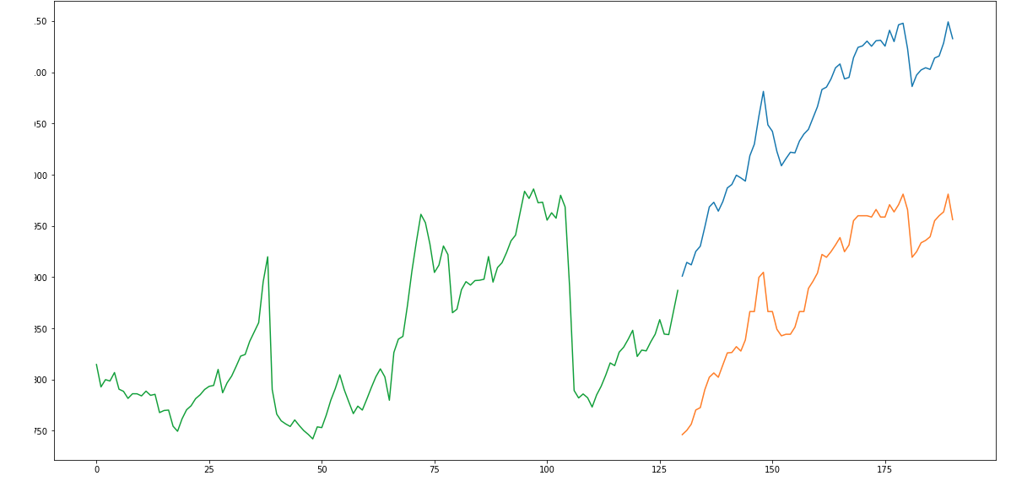
Plot for KNN

Slide 16
ARIMA
ARIMA stands for AutoRegressive Integrated Moving Average. Here, we build on our Moving Average concept to create a better and more sophisticated model for our dataset. ARIMA is a very popular statistical method for time series forecasting. ARIMA models take into account the past values to predict the future values. There are three important parameters in ARIMA:
p (past values used for forecasting the next value)
q (past forecast errors used to predict the future values)
d (order of differencing)
Parameter tuning for ARIMA consumes a lot of time. So we will use auto ARIMA which automatically selects the best combination of (p,q,d) that provides the least error.

Slide 17
Auto ARIMA, therefore, has an rmse value of 115.98. So, we can say that this model is better than KNN in terms of error.

Slide 18
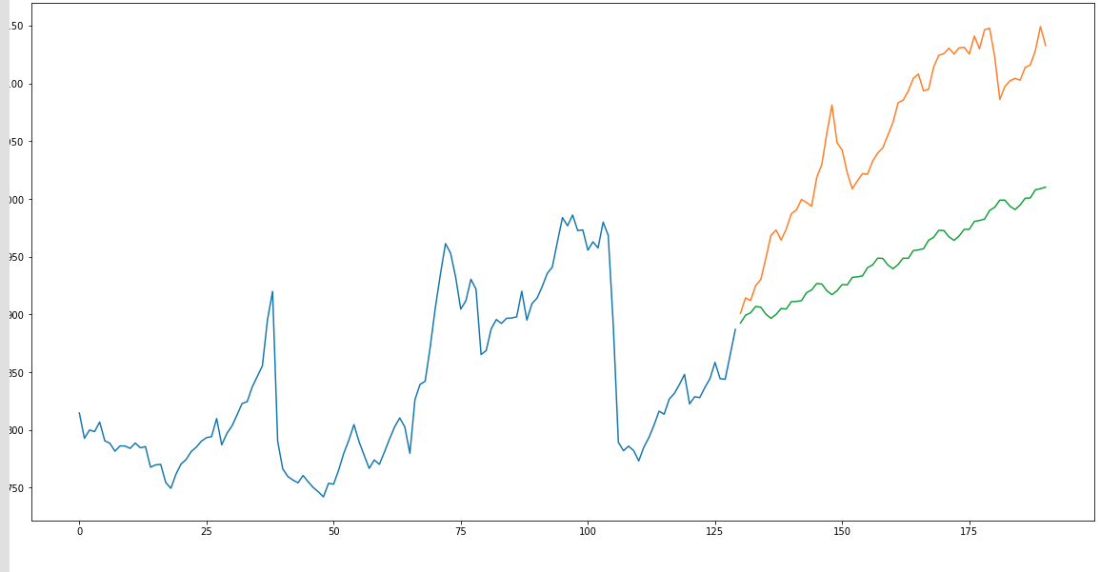
Plot For ARIMA

Slide 19
LSTM
Long Term Short Memory (LSTM) is widely used for sequence prediction problems and have proven to be extremely effective. The reason they work so well is because LSTM is able to store past information that is important, and forget the information that is not. LSTM has three gates:
The input gate: The input gate adds information to the cell state
The forget gate: It removes the information that is no longer required by the model
The output gate: Output Gate at LSTM selects the information to be shown as output

Slide 20
So here the LSTM model gives us an error value of 87.19, approximately. Thus, LSTM is better than all of the other models, except for Linear Regression.

Slide 21
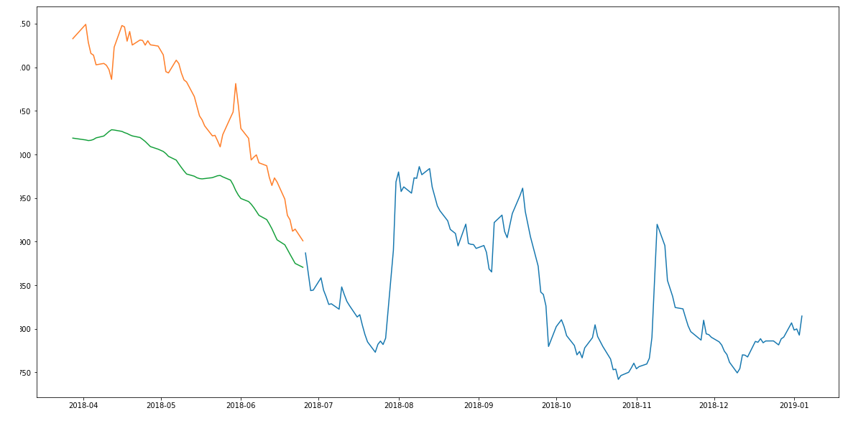
Plot for LSTM

Slide 22
Conclusion
From the five models we have used : Moving Averages, KNN, Linear Regression, ARIMA, and LSTM, we can see that Linear Regression gives us the least error when being fitted with the stock market data.
Therefore, using the Linear Regression model while predicting the stock market values is going to give us the least error in the prediction values.

